Slide 1
Machine Learning implementation of two dimensional Ising Model
지도 교수 : 이 태 진
양자시공간 연구실 박형선
강원대학교 물리학과 박 형 선
Kangwon National University Department of Physics 양자시공간 연구실
Notes:
Today i want explain my graduation thesis about ising model and machine learning. it has been done last year during six month. it was my first research, personally, i think it was very intersting.

Slide 2
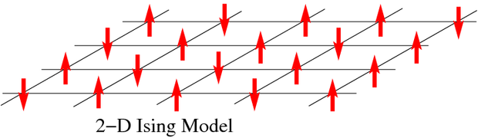
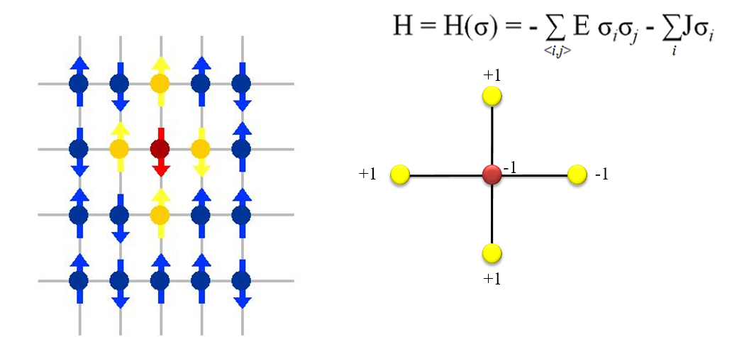
1. Introduction – 2D Ising model
used for modeling ferromagnetic and anti-ferromagnetic materials
2D spin array with size N*N ( square lattice )
Each atom has a spin value 1 or -1
강원대학교 물리학과 박 형 선
Kangwon National University Department of Physics 양자시공간 연구실
Notes:
First of all, we need to remember the basic introduction of the 2 dimensional ising model. In this model, we only consider the 2 dimensional array of the particls. and each particles have only 2 kinds of spin (magnetic moment) up and down. and each particle have only spin-interaction between other particles which are in adjacent postion.

Slide 3
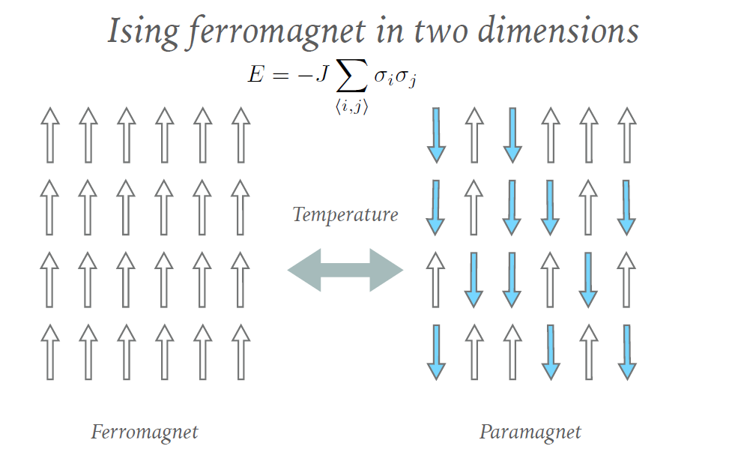
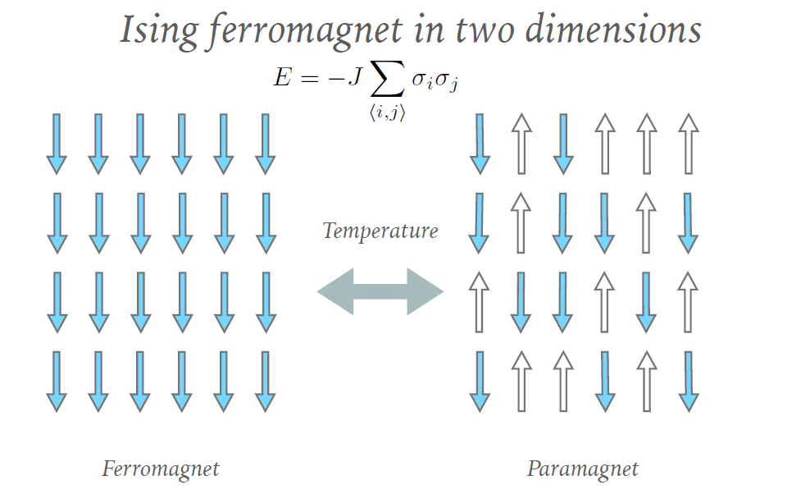
Magnetic phase
Ferromagnetic state by two spin polarization
Paramagnetic state by spin disorder
강원대학교 물리학과 박 형 선
Kangwon National University Department of Physics 양자시공간 연구실
Notes:
and, the ising model have two magnetic state. one is ferromagnic state which means that most of the particles are spin-polarized. the other is paramagnetic state that is unpolarized spin-state.

Slide 4
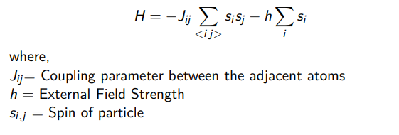
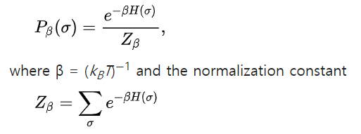
Hamiltonian, Boltzmann distribution
Hamiltonian expression for spin interaction
J = 1 : Coupling parameter
H = 0 : external magnetic field
Statistical physics model : Boltzman distribution
강원대학교 물리학과 박 형 선
Kangwon National University Department of Physics 양자시공간 연구실
Notes:
and, also we should remember the classcial formual of the classical hamilitonian(just same as classcial energy) and thermal probability distribution so called Boltzman distribution.

Slide 5
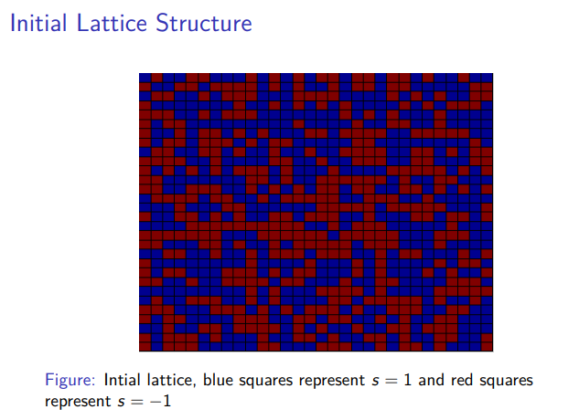
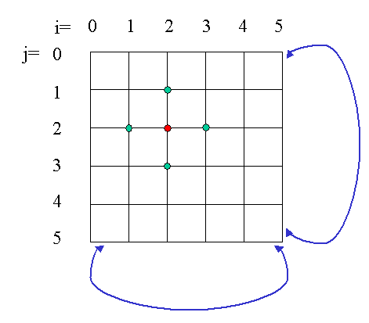
2. Metropolis-Hastings algorithm
Initial random spin state
Periodic boundary conditions
Flip and sweep / Compute the Energy change
Periodic boundary conditions
If delta E < 0, accept this configuration and continue this process
Else, accept this configuration with a probability of p = Boltzmann factor, else retain the old configuration
강원대학교 물리학과 박 형 선
Kangwon National University Department of Physics 양자시공간 연구실
Notes:
so, before we get into the story of machine learning, we consider the process to get a dataset . especially we want to get a large dataset. because if you do something about machine learning, you would definittely need a large dataset.
so, for the sake of it, we use some algorithm so called Metropoilis-hastings algorithm.

Slide 6
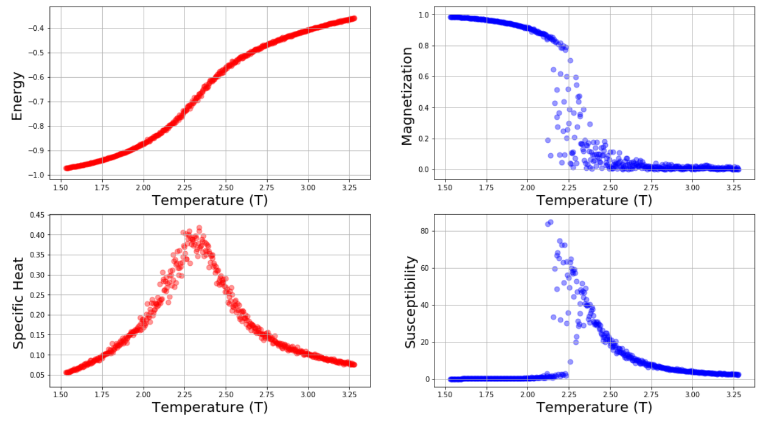
Python implementation plots
강원대학교 물리학과 박 형 선
Kangwon National University Department of Physics 양자시공간 연구실
Notes:
so, if we contiune the metropolis-hasting algorithm, we get four physical measurement. energy, magnetization, specific heat, magnetic susceptibility.
in this model, the critival temperature(so called quiri temperature) is about 2.269 . and we can see that the phase of the configuration is changing near by the quri temperature, espeicially i thought that magnetization is very important. because it is

Slide 7
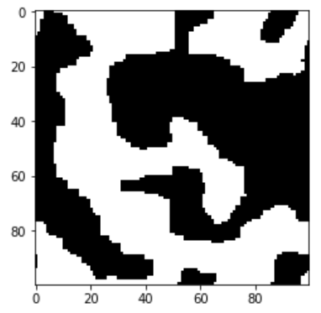
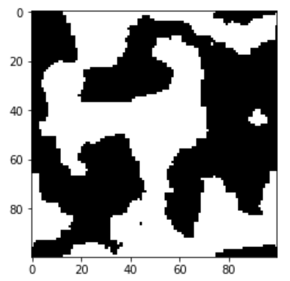
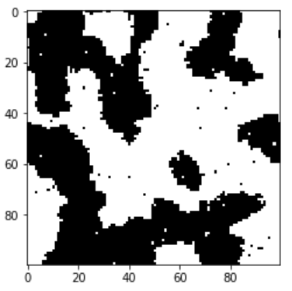
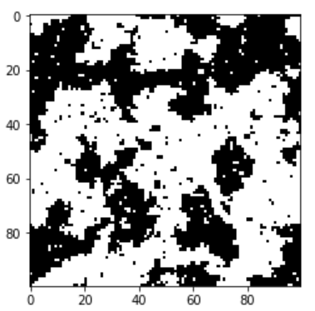
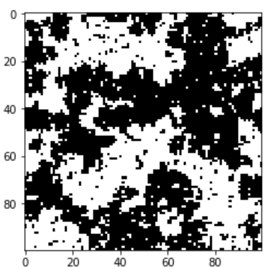
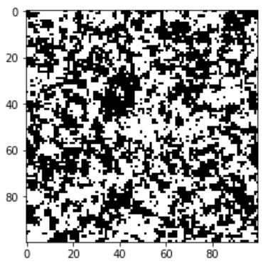
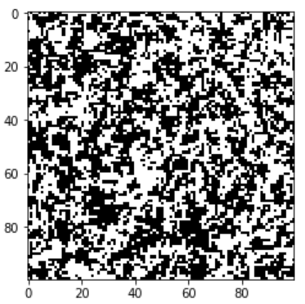
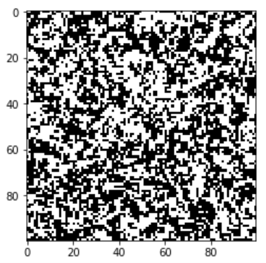
Representation of Ising state
T = 0.5
T = 1.0
T = 1.5
T = 2.0
T = 2.269
T = 3.0
T = 3.5
T = 3.5
강원대학교 물리학과 박 형 선
Kangwon National University Department of Physics 양자시공간 연구실
Notes:
so, eventually we can get a enough dataset(2 dimensional ising configuration as an image data, and energy, magnetization,,.. etc. as a useful labels)

Slide 8
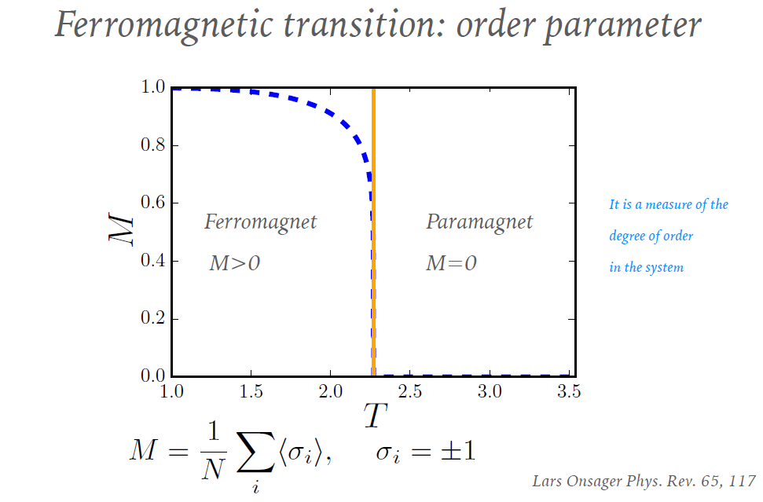
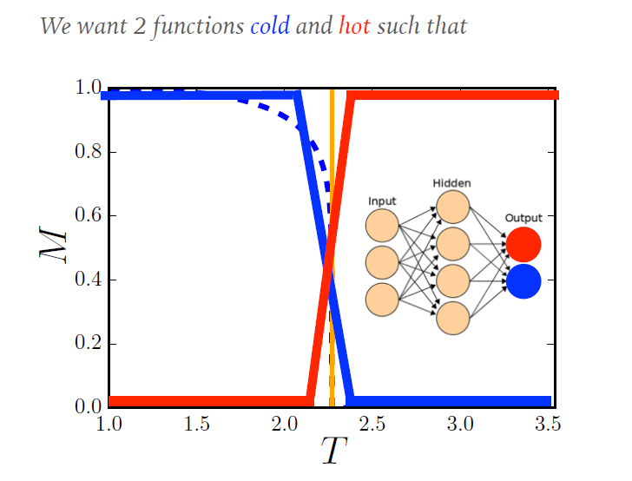
3. The Objective of ML
We`d like to look for phase transition and recognition curve without Hamiltonian information on the system through Machine Learning
강원대학교 물리학과 박 형 선
Kangwon National University Department of Physics 양자시공간 연구실
Notes:
after that, our objective of machine learning is to train the neural network to classfiy the magnetic phase in the ising model.

Slide 9
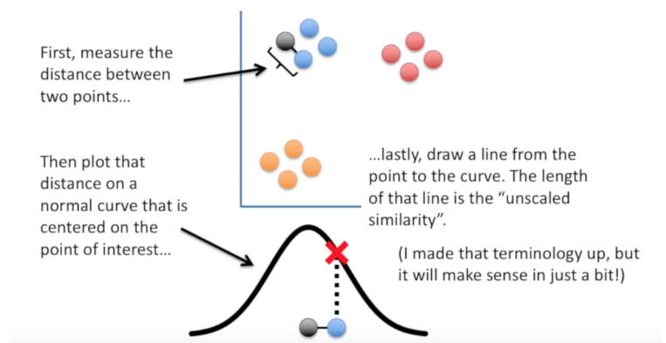
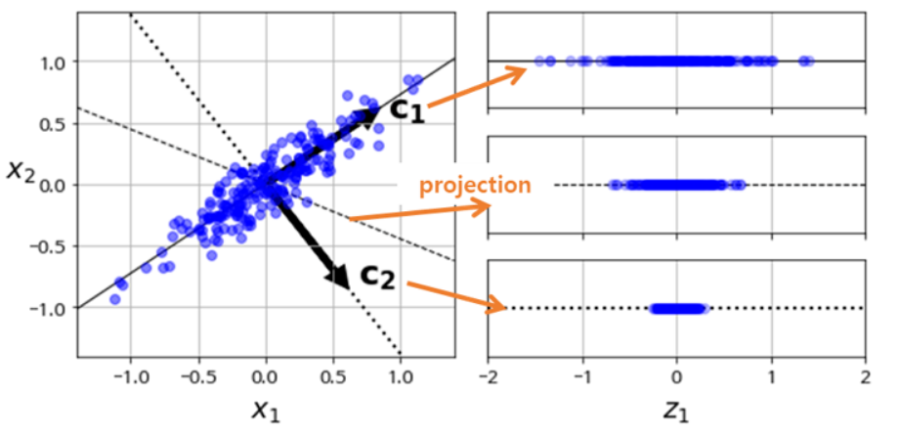
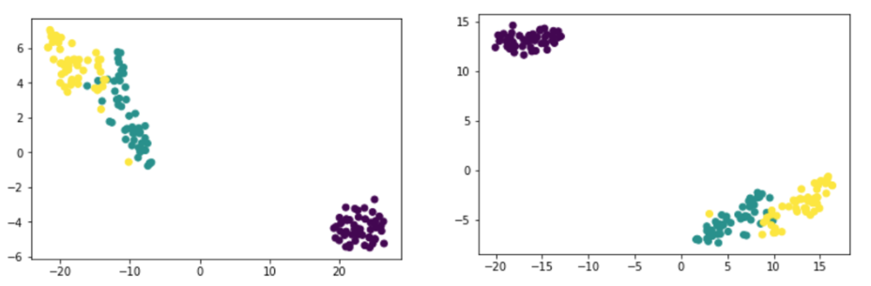
4. Dimensionality Reduction(PCA, T-SNE)
High dimension -> Low dimension
Higher performance of Classifier
강원대학교 물리학과 박 형 선
Kangwon National University Department of Physics 양자시공간 연구실

Slide 10
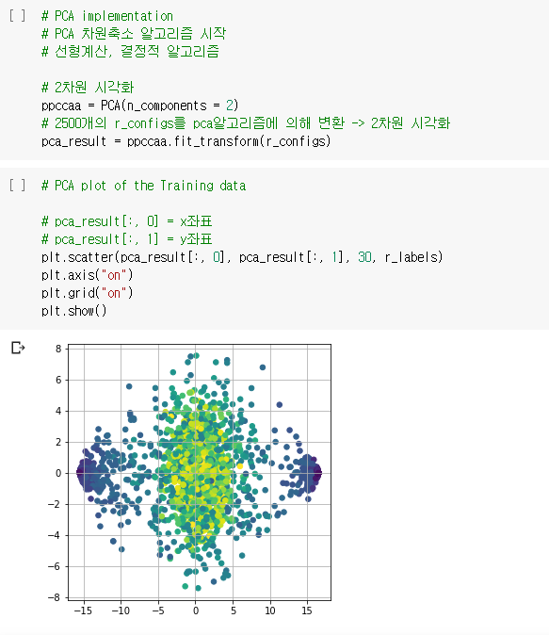
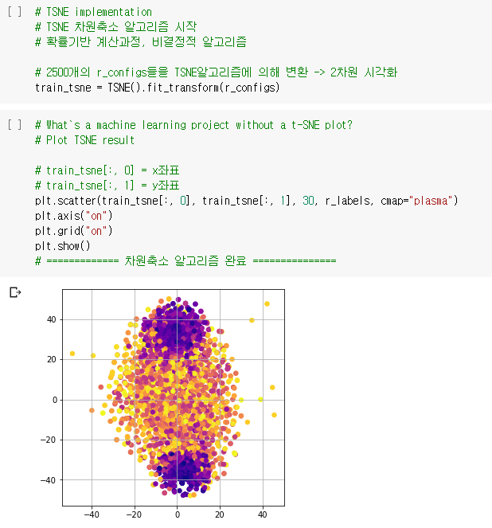
Source Code
강원대학교 물리학과 박 형 선
Kangwon National University Department of Physics 양자시공간 연구실

Slide 11
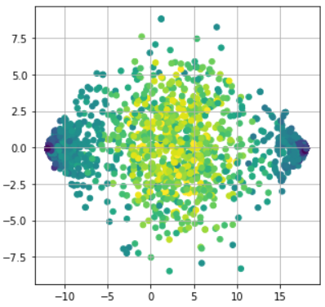
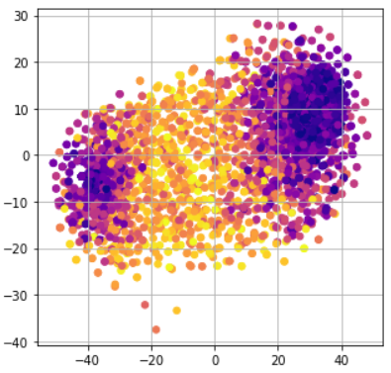
Dimension reduction on Ising model
PCA
t-SNE
Low temperature – Two ferromagnet state(up or down polarization)
High temperature – paramagnet state
강원대학교 물리학과 박 형 선
Kangwon National University Department of Physics 양자시공간 연구실

Slide 12
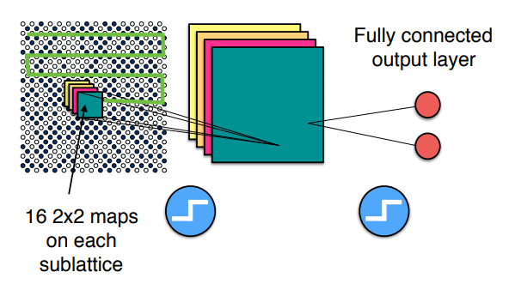
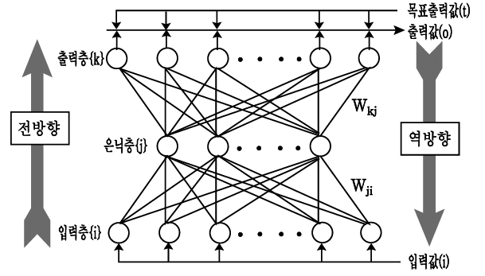
5. CNN(Convolutional Neural Network)
SGD
Weight update
Linear output
Activation function
Step1 : Feature extraction
Step2 : Neural network
Artificial Neural Network : Input layer + hidden layer + output layer
Direction : forward propagation or back propagation
강원대학교 물리학과 박 형 선
Kangwon National University Department of Physics 양자시공간 연구실
Notes:
so, we use the network that is called CNN(Convolutional neural network). that is a typical way when you want to do something about image recognition. so The fundamental idea of this research was the applilcation for the 2d ising configuration to be interpreted, and recognized in machine learning with a labeling data that was obtained already in previous algorithm step.

Slide 13
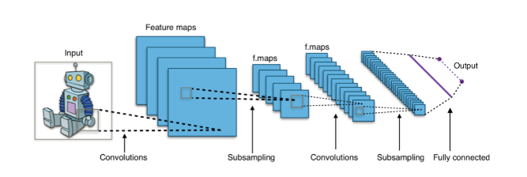
General CNN architecture
General CNN architecture
Input[image] -> Conv2D -> Relu -> Conv2D -> Relu -> Pooling -> … -> FCL -> … -> output[label]
강원대학교 물리학과 박 형 선
Kangwon National University Department of Physics 양자시공간 연구실
Notes:
and, this is the general cnn architecture. first of all, there`s an input image, and the network take an convolution process for the image, and the useful traits(features) are extracted and compressed using subsampling(max-pooling) and that is done repeatedly for a while. then, orignal image(as a configuration of multplel pixcel values) is transformed to one-dimensional array of high-level, and abstract meaning-ful values, and it is taken as an input data to the fully-connected layer.

Slide 14
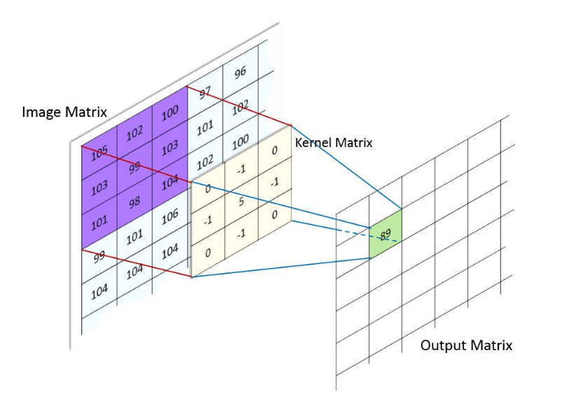
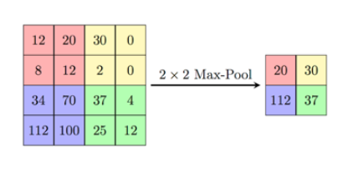
Convolution and Pooling
Convolution : Feature extraction using Kernel Matrix(filter)
(Max)Pooling : Sub-sampling, Feature compression
강원대학교 물리학과 박 형 선
Kangwon National University Department of Physics 양자시공간 연구실

Slide 15
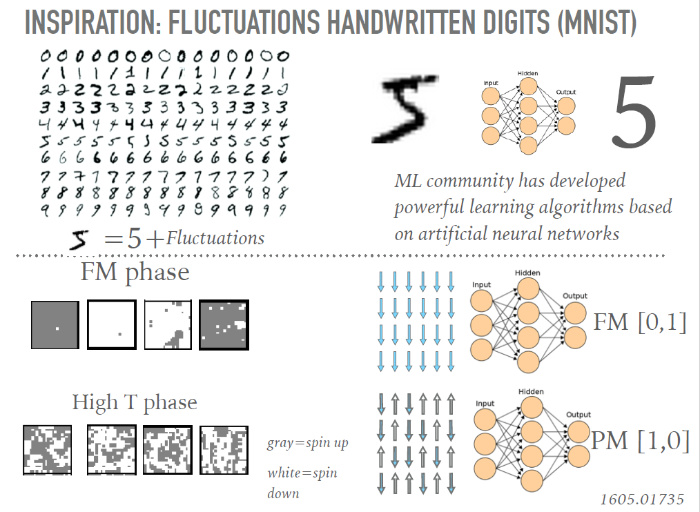
Compatibility of input data for CNN
MNIST
2d pixel array
2d spin array
One-hot vector
Training data
강원대학교 물리학과 박 형 선
Kangwon National University Department of Physics 양자시공간 연구실

Slide 16
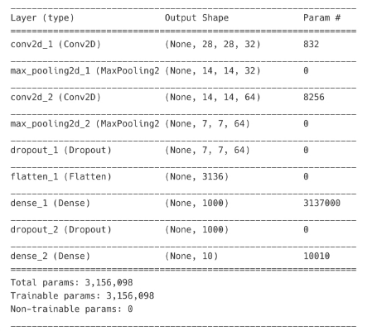
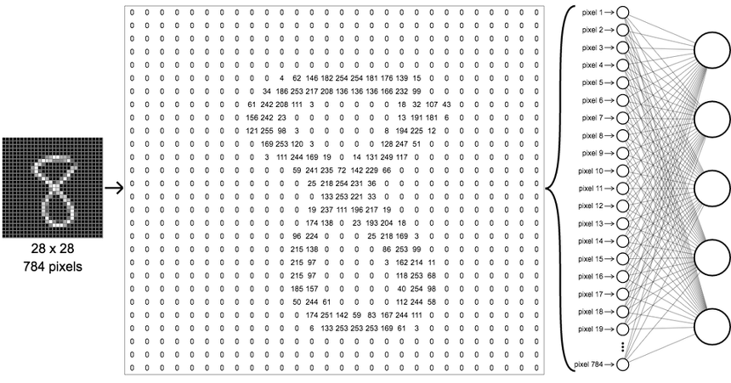
Neural Network Scheme - MNIST
강원대학교 물리학과 박 형 선
Kangwon National University Department of Physics 양자시공간 연구실

Slide 17
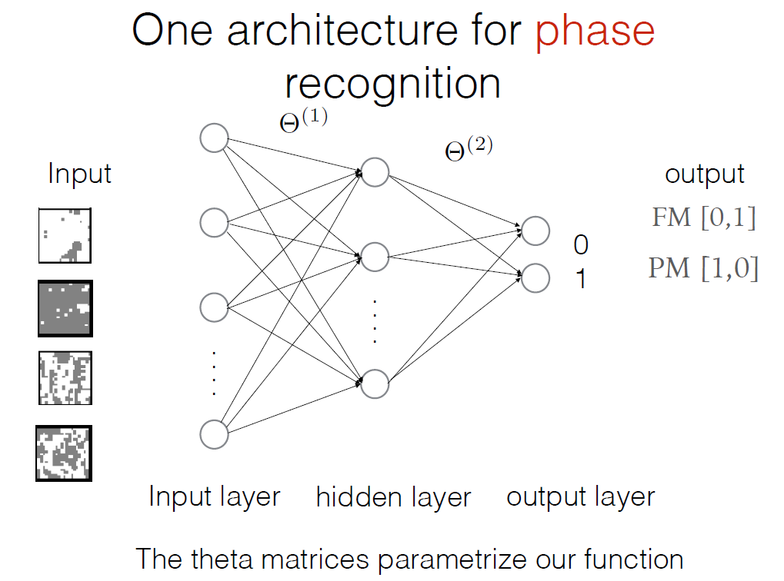
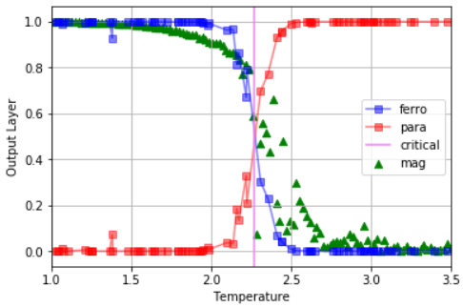
6. Conclusion
Recognition curve
Phase Recognition and identification success
Without information about system Hamiltonian, assemble for order parameter (magnetization)
강원대학교 물리학과 박 형 선
Kangwon National University Department of Physics 양자시공간 연구실

Slide 18
감사합니다
Reference : Juan Carrasquilla and Roger G. Melko,
Machine Learning phase of matter
강원대학교 물리학과 박 형 선
Kangwon National University Department of Physics 양자시공간 연구실

Slide 19
Supplement
강원대학교 물리학과 박 형 선
Kangwon National University Department of Physics 양자시공간 연구실

Slide 20
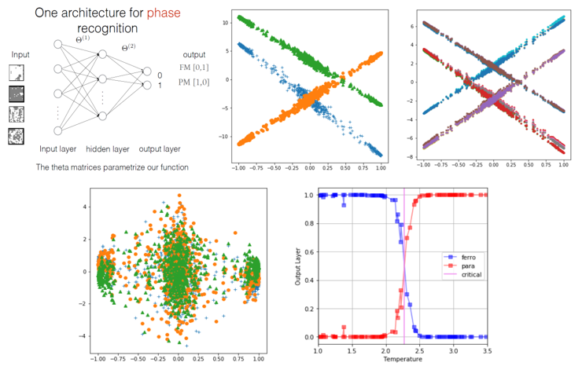
Toy model Result
강원대학교 물리학과 박 형 선
Kangwon National University Department of Physics 양자시공간 연구실

Slide 21
Image = Array
강원대학교 물리학과 박 형 선
Kangwon National University Department of Physics 양자시공간 연구실

Slide 22

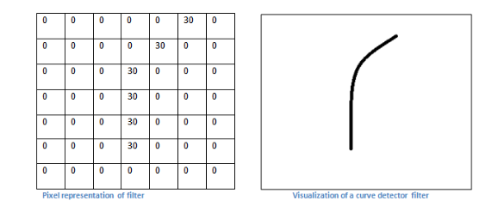
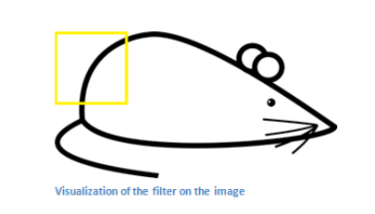
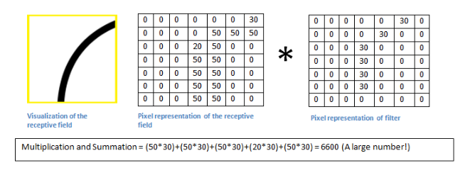
Filter, Convolution example
강원대학교 물리학과 박 형 선
Kangwon National University Department of Physics 양자시공간 연구실

Slide 23
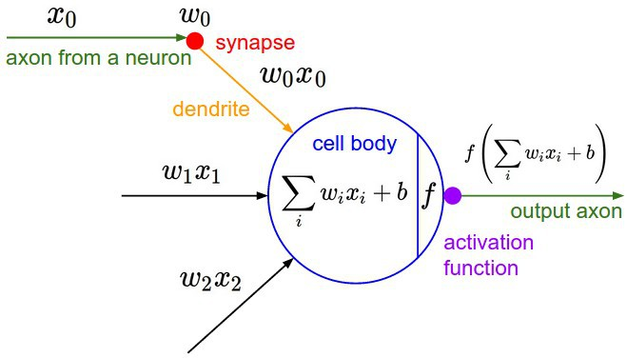
Single Perceptron
Sing Perceptron architecture
Input data -> Weighted, and adding bias -> Activation function -> Output
강원대학교 물리학과 박 형 선
Kangwon National University Department of Physics 양자시공간 연구실

Slide 24
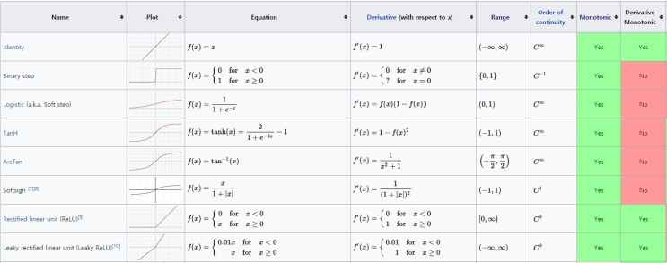
Activation functions
강원대학교 물리학과 박 형 선
Kangwon National University Department of Physics 양자시공간 연구실

Slide 25
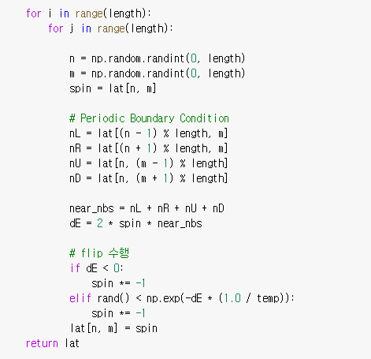
Metropolis algorithm Source Code
강원대학교 물리학과 박 형 선
Kangwon National University Department of Physics 양자시공간 연구실

Slide 26
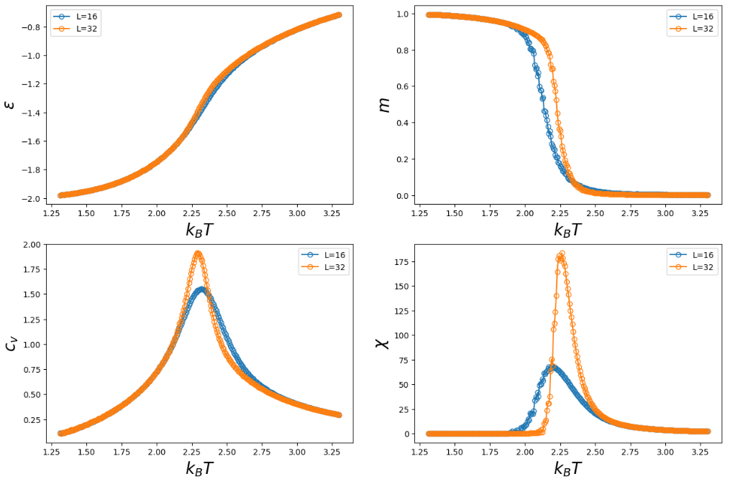
Python implementation plots
강원대학교 물리학과 박 형 선
Kangwon National University Department of Physics 양자시공간 연구실

Slide 27
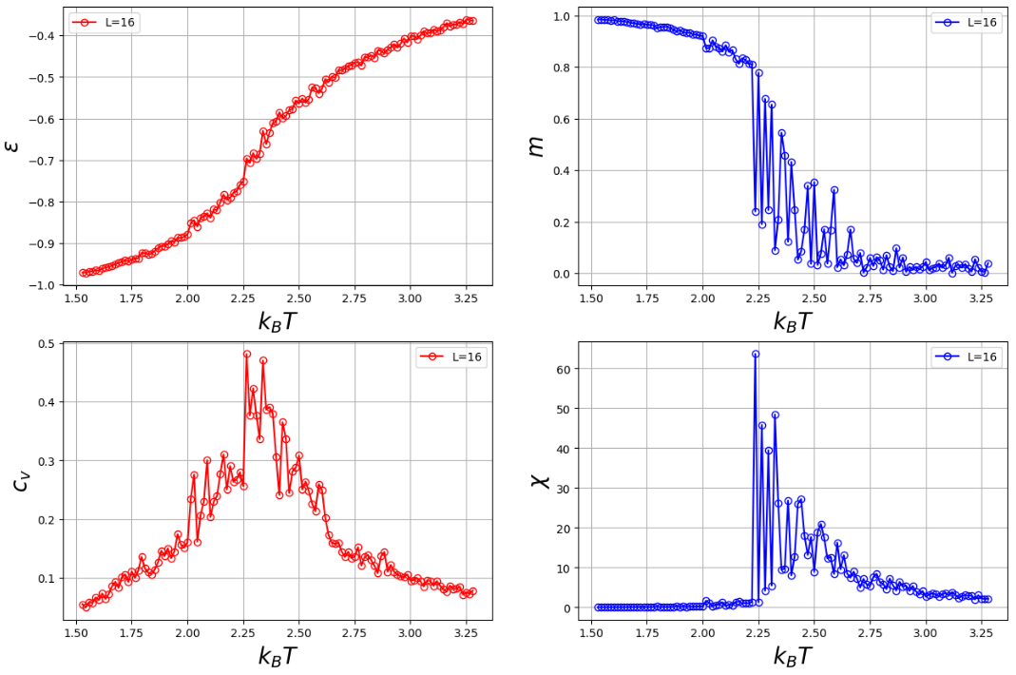
Python implementation plots
강원대학교 물리학과 박 형 선
Kangwon National University Department of Physics 양자시공간 연구실

Slide 28
Python implementation plots
강원대학교 물리학과 박 형 선
Kangwon National University Department of Physics 양자시공간 연구실

